Slide 1
Lifestyle Group
Session 2: Healthy Boundaries

Slide 2
Agenda
Welcome
Ground Rules Review
Defining Boundaries
Setting Boundaries
Effective Boundaries
Ignored Boundaries

Slide 3

Welcome
First Name
Why did you attend this group this evening?

Slide 4
Ground Rules
Lifestyle Group is a safe place: what we say here, stays here.
One person speaks at a time.
Animal Tax
No idea is a bad idea.
Total honesty!
Anyone can hit the “PAUSE” button on discussion.

Slide 5
Boundaries
Boundaries define our emotional and physical space.
They mark where you end, and another person begins.
Boundaries help in being authentic.
They are crucial for emotional well-being and maintaining personal identity.

Slide 6
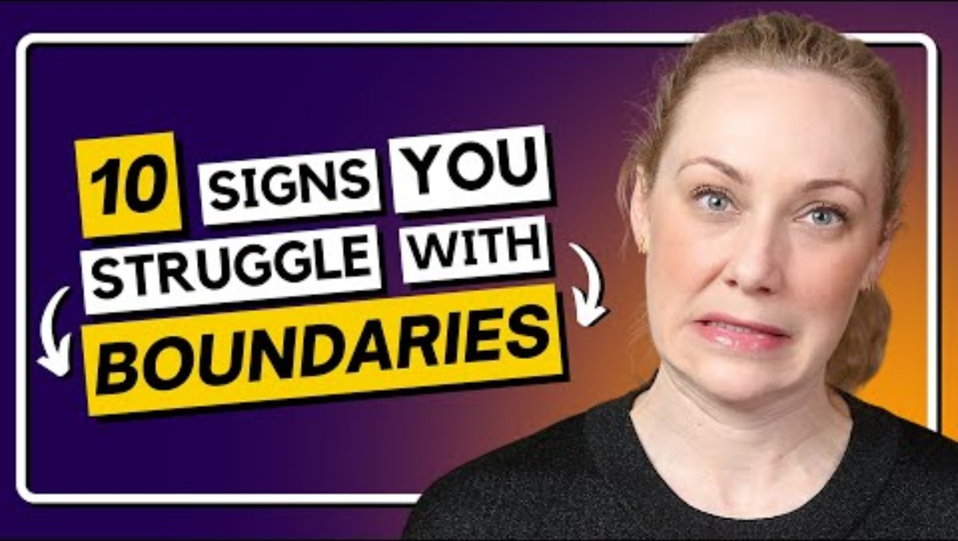
YouTube Clip

Slide 7
Question:
How do you define your personal boundaries, and what steps do you take to communicate them to others?

Slide 8
Setting Boundaries
Setting boundaries is a form of self-care and respect.
Boundaries enable us to be generous by giving without depleting ourselves.
They foster growth by making others aware of their behaviors.
Question:
Do you have an example of an experience in which setting a boundary significantly improved a relationship or situation for you?

Slide 9
Effective Boundaries
Benefits include self-esteem boost, increased respect from others, and encouragement of honest communication.
Guidelines include being direct yet gracious, avoiding debates or over-explanations, and being consistent in enforcement.
Question:
Which of these guidelines do you find most challenging, and how do you overcome that challenge?

Slide 10
Ignored Boundaries
Signs of ignored boundaries include feeling enmeshed, excessive detachment, and feelings of being disrespected or disregarded.
Recognizing these signs is the first step toward setting healthier boundaries and acting when your boundaries are tested.
Question:
Have you ever felt any of these signs in your personal or professional life, and how did you address it?

Slide 11
Open Discussion
Questions?
Comments?
Suggestions?

Slide 12
Thank you
Next Meeting:
Thursday, April 18, 2024
5:30 PM
Same Zoom Link!

